Slide 1
Requesting Appointments & Managing Certifications
Broker Training
2021
10142021

Slide 2
Training Topics
01 — Getting Started
02 — Requesting & Managing Your Appointment
03 — Individual and Family Plan Appointment Process
04 — Medicare Advantage Plan Appointment Process
04 — Ready to Sell

Slide 3
Getting Started

Slide 4
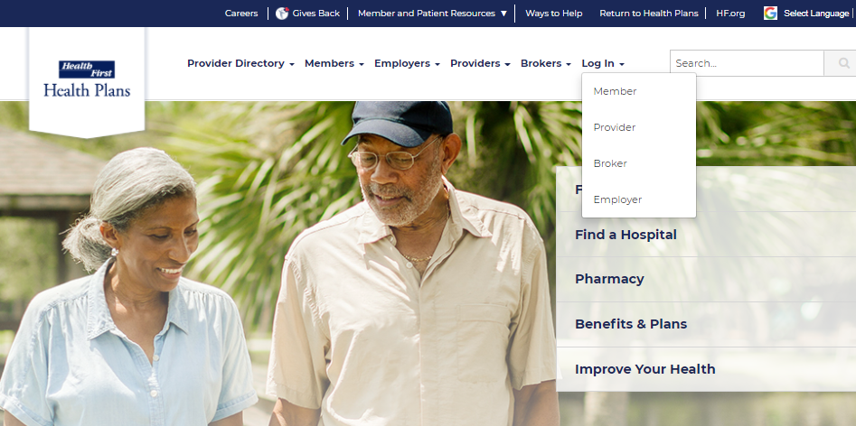
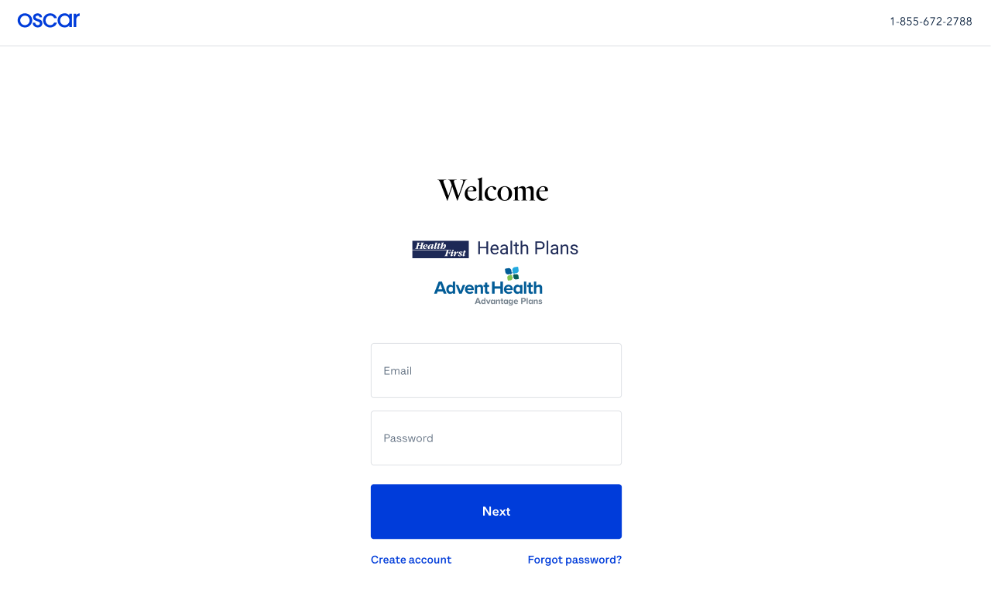
Getting Started – Log In
From the public website, locate the Broker Portal login page:
1. myHFHP.org or myAHPlan.com
2. Click “Login”
3. Click “Broker”
4. Log in
Note: Google Chrome is recommended

Slide 5
Requesting & Managing Your Appointment

Slide 6
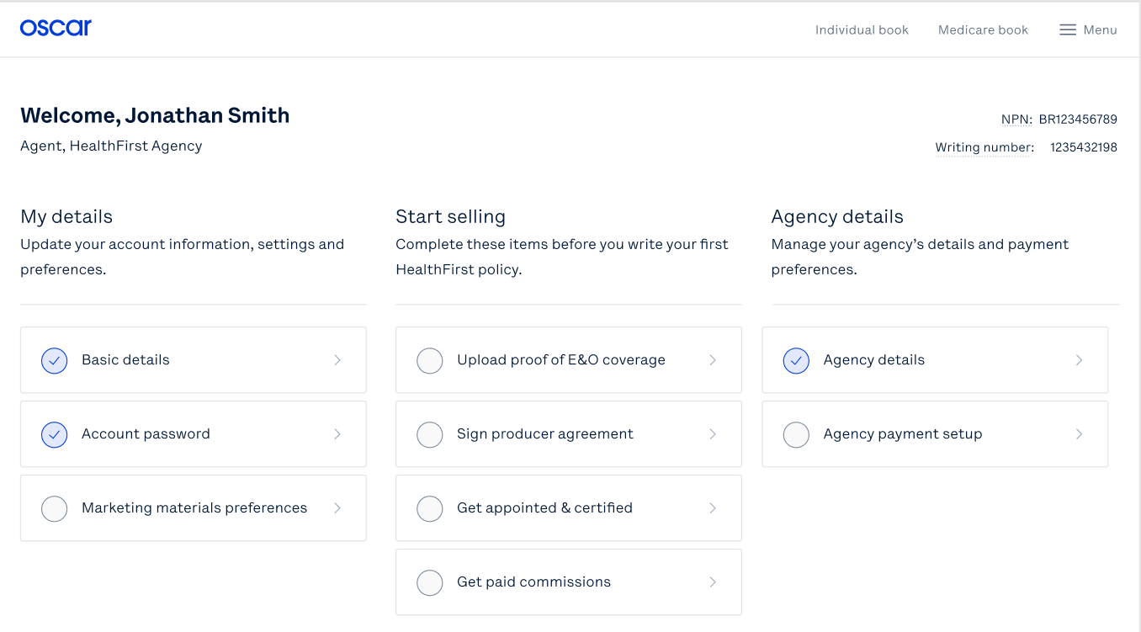
Broker Account: Homepage
As part of the appointment process, brokers will need to complete all sections within the main homepage of the Broker Portal that pertain to you.
Keeping your basic details updated
Letting us know how you'd like to be paid commissions
Requesting to sell Individual and Family Plans
Requesting to sell Medicare Advantage Plans
Principal Agents- managing your agency details
Agent, Health First Agency
Complete these items before you write your first Health First policy.
Note: The blue check mark will indicate that section is complete

Slide 7
Broker Account: Homepage
If you will be selling Individual and Family Plans and Medicare Advantage Plans, you will need to complete all steps required under each of these sections.
The blue check mark will indicate that section is complete.
Agent, Health First Agency
Complete these items before you write your first Health First policy.

Slide 8
Individual and Family Plan
Appointment Process

Slide 9
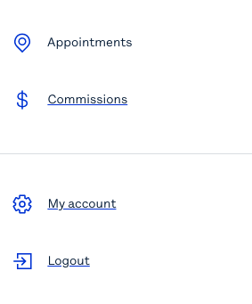
Individual and Family Plan (IFP) Appointment Process
Select A or B to begin requesting appointment to sell IFP products
Agent, Health First Agency
B
Complete these items before you write your first Health First policy.
A

Slide 10
Individual and Family Plan (IFP) Appointment Process
Request a new appointment
C
A
B
Confirm your appointment status
Review your existing appointments

Slide 11
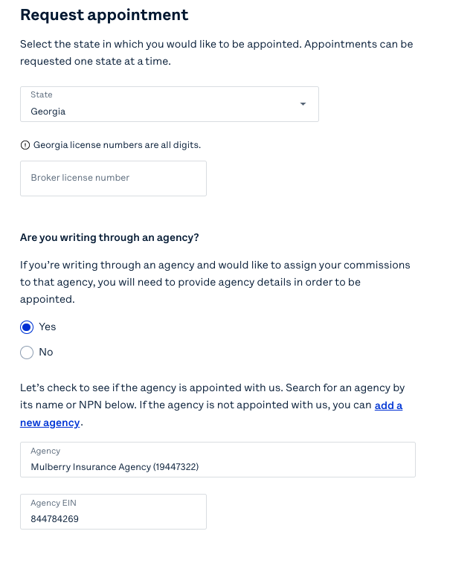
Individual and Family Plan (IFP) Appointment Process
1
1. Select the state in which you are requesting an appointment (HFHP and AHAP only available in FL)
2. Enter your State Broker License Number
3. Select if you are writing through an Agency
4. If you are writing through an Agency, your Agency information should be pre-populated
Florida
2
3
4

Slide 12
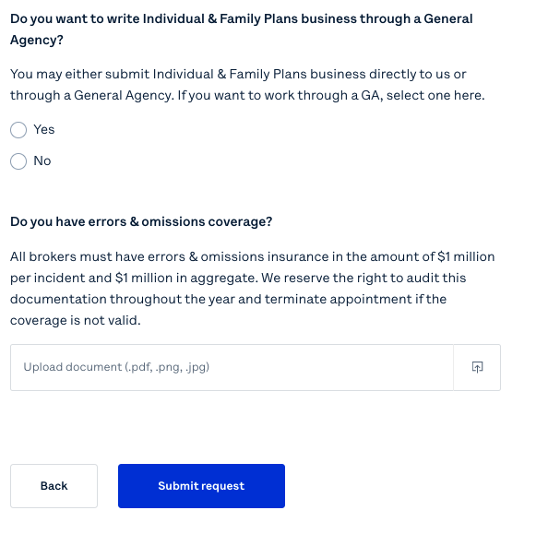
Individual and Family Plan (IFP) Appointment Process
5
5. Select if you are writing through a General Agency (or FMO)
6. Upload E&O Coverage
7. Submit your request
Note: Appointment requests will be processed between 5-7 business days
6
7

Slide 13
Medicare Advantage Plan
Appointment Process

Slide 14
Medicare Advantage Plan Appointment Process
Agent, Health First Agency
Complete these items before you write your first Health First policy.
Select “Get certified to sell Medicare” to begin

Slide 15
Medicare Advantage Plan Appointment Process
Select “2022 Medicare Advantage Certification” to begin the certification process

Slide 16
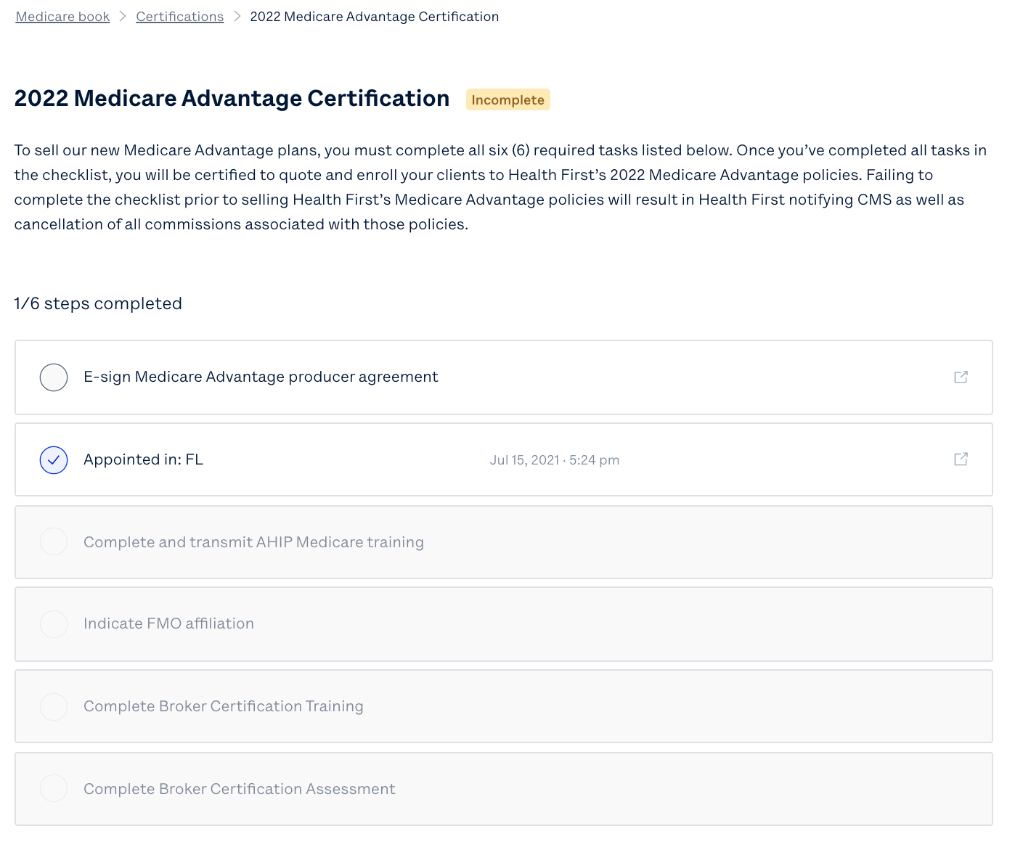
Medicare Advantage Plan Appointment Process
Complete the 6 steps outlined to fulfill the Health First Medicare Advantage 2022 Certification
Sign the MA Producer Agreement
Become appointed in FL
Complete AHIP Medicare Training
Indicate FMO affiliation
Complete Health First required Broker Certification training
Complete Health First Broker Certification assessment

Slide 17
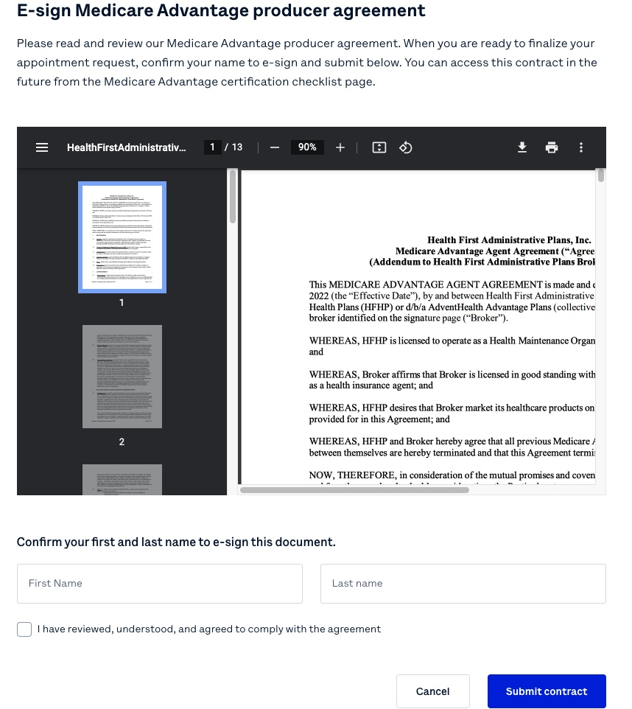
MA Appointment Process: E-sign MA Producer Agreement

Slide 18
MA Appointment Process: Request Appointment
If already appointed in Florida, this will have a blue check to confirm it is complete. Otherwise, this tab will direct you to the below prompt to Request appointment

Slide 19
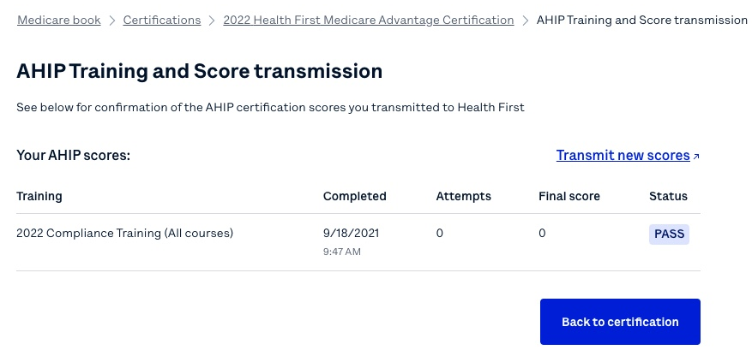
MA Appointment Process: Complete and transmit AHIP Medicare training
If you have already completed your Health First Medicare Certification (HFMC) requirement and provided your AHIP Certification to Health First by 8/20/21, your information has been transferred to Oscar. You will see this information in your Oscar Broker Portal by 9/5/21.

Slide 20
MA Appointment Process: Indicate FMO Affiliation
Either list the FMO you work through and select Save FMO, or check the box to indicate ‘I am not affiliated with an FMO’ and select Save FMO

Slide 21
MA Appointment Process: Complete Broker Certification Training
Clicking this box directs you to the link below to review a Power Point presentation entitled
‘Medicare Advantage Plans Overview – Medicare Required Documentation Course’
https://d3ul0st9g52g6o.cloudfront.net/broker/healthfirst/Medicare_Advantage/HealthFirst_PY22_Medicare_Training.pdf
Complete this training before moving to the final certification step
Note: If you have already completed your Health First Medicare Certification (HFMC) requirement and provided your AHIP Certification to Health First by 8/20/21, your information has been transferred to Oscar. You will see this information in your Oscar Broker Portal by 9/5/21.

Slide 22
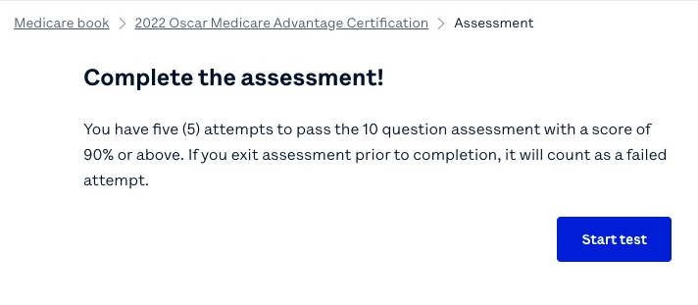
MA Appointment Process: Complete Broker Certification Assessment
Note: If you have already completed your Health First Medicare Certification (HFMC) requirement and provided your AHIP Certification to Health First by 8/20/21, your information has been transferred to Oscar. You will see this information in your Oscar Broker Portal by 9/5/21.

Slide 23
Ready to Sell

Slide 24
Ready to Sell
Ensure that all relevant fields are completed prior to selling Health First Health Plans and AdventHealth Advantage Plans.
Agent, Health First Agency
Health First policy

Slide 25
Oscar’s Broker Support Team is here to help
✓ Broker account support
✓ Appointment & certification support
✓ Commissions escalations
✓ Eligibility inquiries
✓ Member inquiries & support
✓ Network/Rx support
Monday through Friday 8:00am - 6:00pm EST
hf-brokers@plusoscar.com
hf-brokercommissions@plusoscar.com
877-693-6489

Slide 26
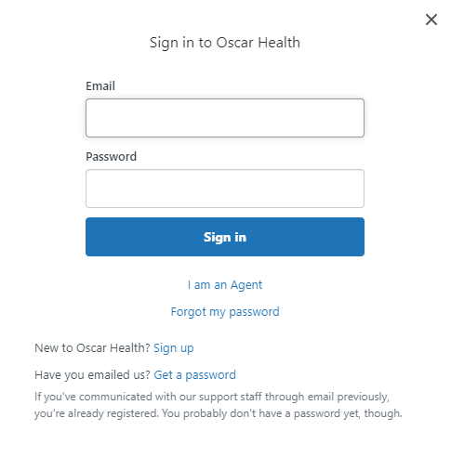
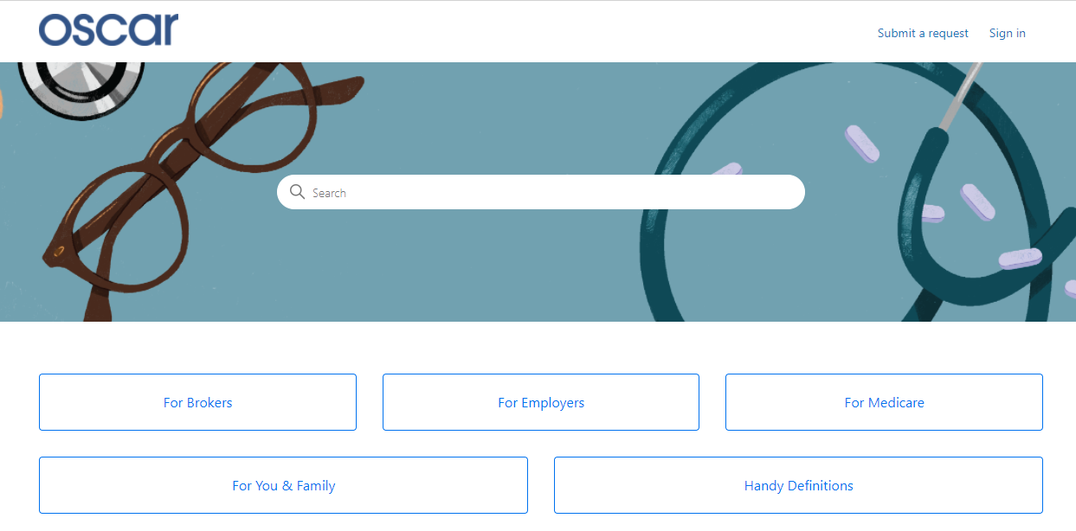
Creating Your Zendesk Account
In order for brokers to communicate with Oscar through the designated emails provided, you will need to create an account through Zendesk. Follow the below steps.
Start at Oscar’s Zendesk Help Center
Click "Sign in" from the top right
A pop-up window will prompt you to sign in. If you don’t have an account, select "Sign up" next to "New to Oscar Health?"
Submit your full name and email address
Click the blue "Sign up" button. Look for an email to complete account set-up.
From your inbox, look for "Welcome to Oscar Health." Click the link to complete creating your password.
You can now successfully communicate to/from, via email, with Oscar.

Slide 27
Health First Health Plans Broker Services is available: Monday through Friday 8:00 a.m. to 5:00 p.m.
For questions contact us at: 321.434.5265 or HFBroker@HF.org

